Slide 1
IMAGE COMPRESSION USING SVD
BY
JAYANT SAXENA PES1201800624
ROHAN .N. KALPAVRUKSHA PES1201802830
Guide- Lavanya krishna

Slide 2
PROBLEM STATEMENT
It is well known that the images are often used in variety of computer applications, are difficult to store and transmit. For example:-
Images captured by satellites are to be transmitted really fast to the space station.
Storage of medical images in hospital are some of the problems which require to be conquered by image compression.

Slide 3
AIM
The aim here is to study image compression using a method called Singular Value Decomposition,which is a tool provided by Linear Algebra.
During Image Compression the important features of the image should remain preserved.

Slide 4
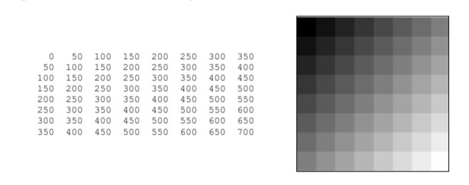
WHAT IS AN IMAGE?
Digital images are a collection of pixels which are stored as matrices in our computers.
Each pixel is characterized by its (x, y) coordinates and its value.
EX:
Here we consider the black portion of the image to be of zero brightness and white to be of maximum brightness,as represented in the given matrix.

Slide 5
REPRESENTING IMAGES AS MATRICES
The process of representing images as a matrix makes mathematical computations of the image easier and since we obtain the image in a matrix form it makes it a viable option to edit and analyze the image using various mathematical operations.
There are various tools (like Gaussian Elimination, Singular Value Decomposition, Linear Transformations etc) for performing operations on a given matrix(image).
But since this report is based on image compression we solely focus on a method called Singular Value Decomposition (S.V.D.).

Slide 6
SINGULAR VALUE DECOMPOSITION (S.V.D.)
SVD states that any matrix A of order(m×n) can be factorized as: A=USV^T
Where U and V are orthogonal matrices with orthonormal Eigen Vectors chosen from AAᵀ and
AᵀA respectively.
S is a matrix of order m×n with ’r’ number of Singular values lying only on the diagonal of this matrix
The entries σ1 ≥ σ2 ≥ σ3 ≥ … ≥ 0 on the diagonal of S are called the singular values (SVs) of A
These σ1 ,σ2 ,σ3,.. σr are found by performing square root of the Eigen value of both AAᵀ and AᵀA.
An example on this method has been performed for a clearer vision .

Slide 7
HOW IS S.V.D. UTILIZED IN IMAGE COMPRESSION?
We can decompose a given image into the three color channels red, green and blue. Each channel can be represented as a (m × n) matrix with values ranging from 0 to 255
We will now compress the matrix A representing one of the channels.
To do this, we compute an approximation to the matrix a that takes only a fraction of the space to store.

Slide 8
HOW IS S.V.D. UTILIZED IN IMAGE COMPRESSION?
We can choose a number k of singular values that we are going to use for the approximation.
The higher this number, the better the quality of the approximation gets but then more data is needed to encode it.
We can take only the first k columns of U and V and the upper left (k × k)-square of S, containing the largest k (and therefore most important) singular values.

Slide 9
HOW IS S.V.D. UTILIZED IN IMAGE COMPRESSION?
Compressed image size formula:-
(m×k)+k+(k× n)= k × (1 + m + n) in pixel
Here 1 pixel=3bytes (in case of coloured images) or
1pixel = 1byte (in case of black and white image)
Where m × n computes the order of original matrix (of original image), k is the rank or the number of singular values we are using for compression.

Slide 10
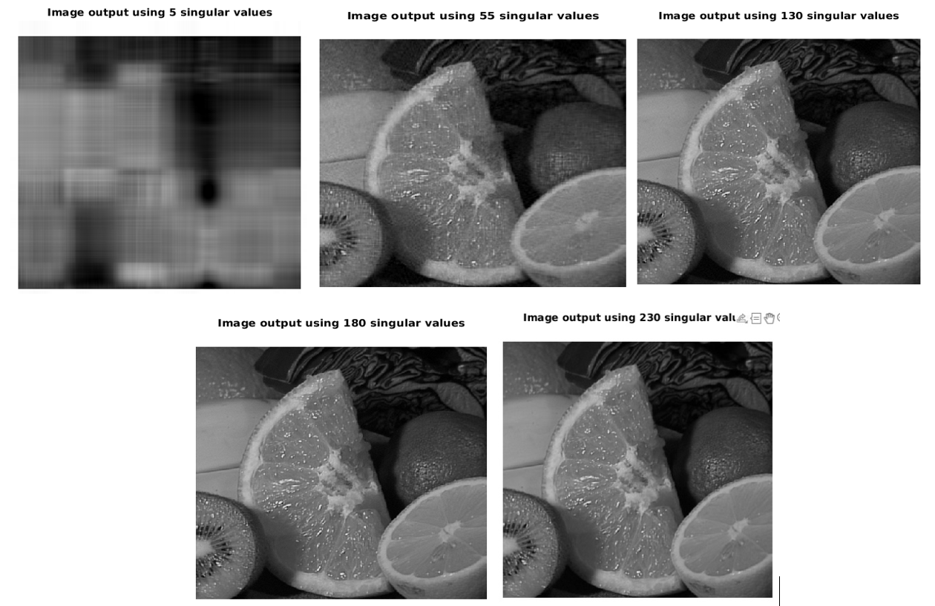
IMAGES WITH VARIED SINGULAR VALUES(USING MATLAB)

Slide 11
COMPARING IMAGE SIZE WITH DIFFERENT K VALUES
Sl. No. | Value of k | Image Size corresponding to k | Compression Ratio=Original Size/Compressed Size
1. | 230 | 230(1+m+n)pixels | => (almost negligible compression)
2. | 180 | 180(1+m+n) pixels | => 1.30
3. | 55 | 55(1+m+n) pixels | => 4.18
4. | 5 | 5(1+m+n) pixels | => 46(very highly compressed)

Slide 12
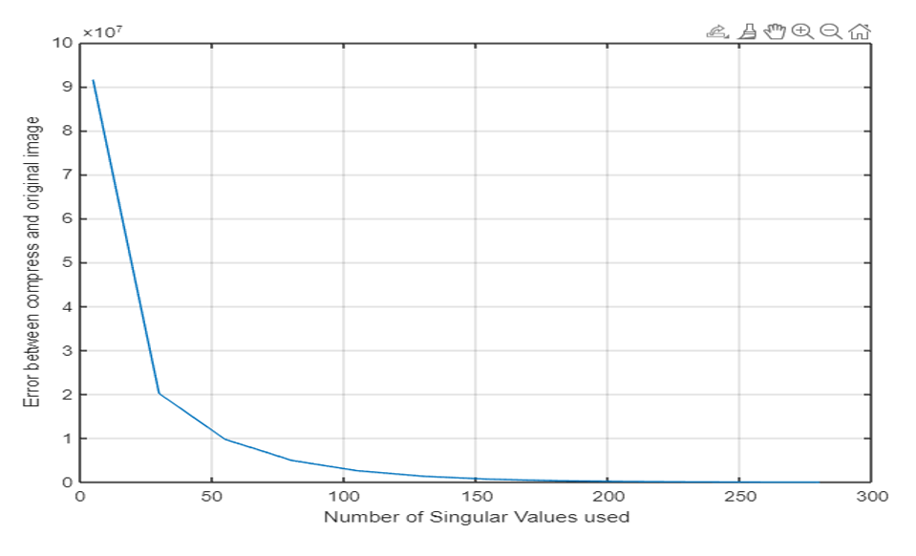
ERROR GRAPH

Slide 13
RESULT
Our report proves that S.V.D is one of the viable techniques for image compression.
We clearly see that with decrease in rank of the matrix(image) the size of the image reduces drastically.
Also with the decrease in k there is increase in error and hence the error is maximum when the k value is minimum.

Slide 14
SUMMARY AND CONCLUSIONS
Image compression is a technique of efficiently coding digital image to reduce the number of bits required in representing an image.
We described how an image is represented in a form of matrix which it easier for applying mathematical computations.
We analyzed the Singular Value Decomposition Method ,its formula expression and specified the nomenclature of variable used.
It is evident from our report that S.V.D. deals with all the irrelevant information in the matrix and presents only the required information to the user.

